Slide 1


Traveling by air is safer than automobile
DSC640 – FINAL PROJECT
BELLEVUE UNIVERSITY
THIP RATTANAVILAY

Slide 2

AIRLINE REMAIN ONE OF THE SAFEST WAY TO TRAVEL
Airline vs Car travel
Facts
Reports

Slide 3

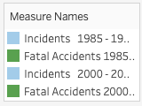
Aviation Committed to Safety
The airline industry has been committed to safety travel for decades.
During the past 20 years fatalities has decreased by 95% percent as measured by fatalities per 100 million passengers.
Not only has the number of incidents declined 57% over the two time periods.
Data shows that you are less likely to be involved in an incident these days, being in an incident is far less likely to be fatal than it was previously.

Slide 4


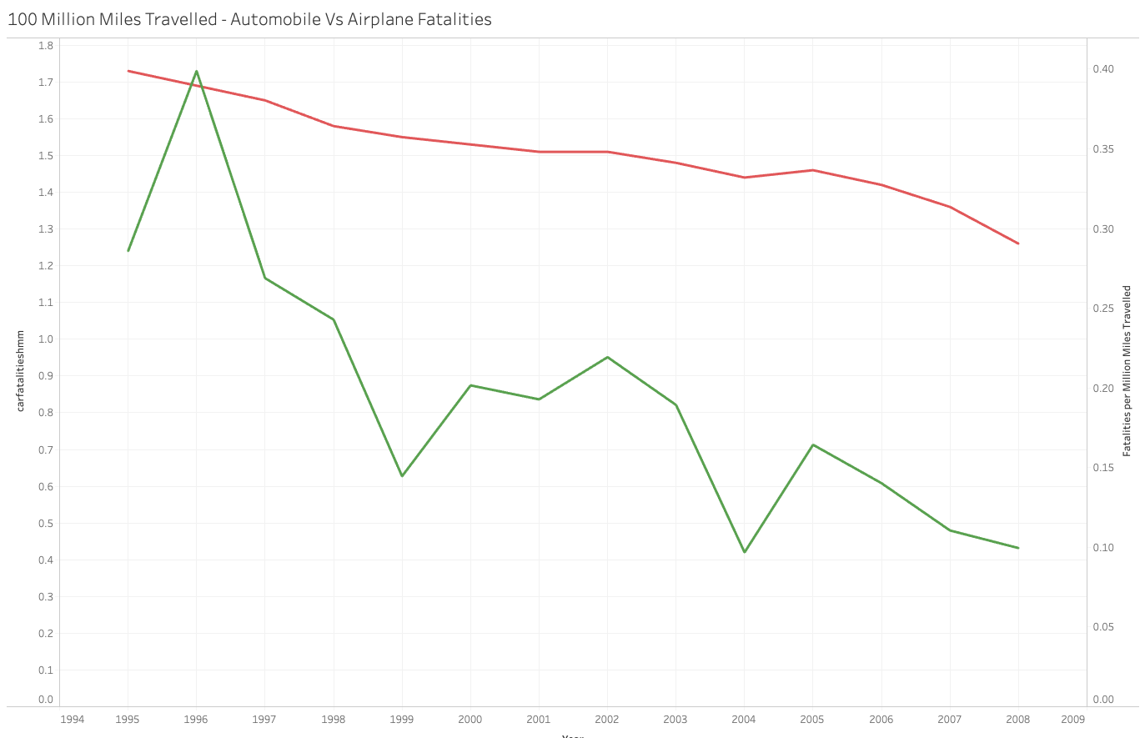
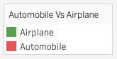
Air Travel VS Automobile
In 2008, you were 13x times more likely to die in a passenger vehicle than an airplane per mile travelled
As for Car fatalities, this trend will likely continue.

Slide 5

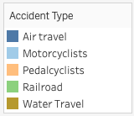
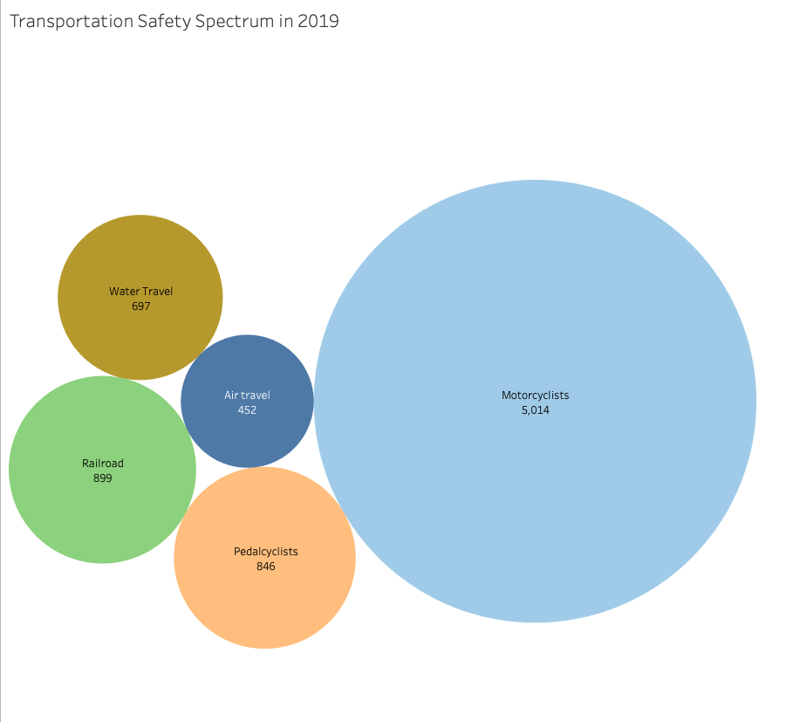
Transportation Safety spectrum
Motorcycle accidents are 95% higher than
Air Travel reported in 2019

Slide 6
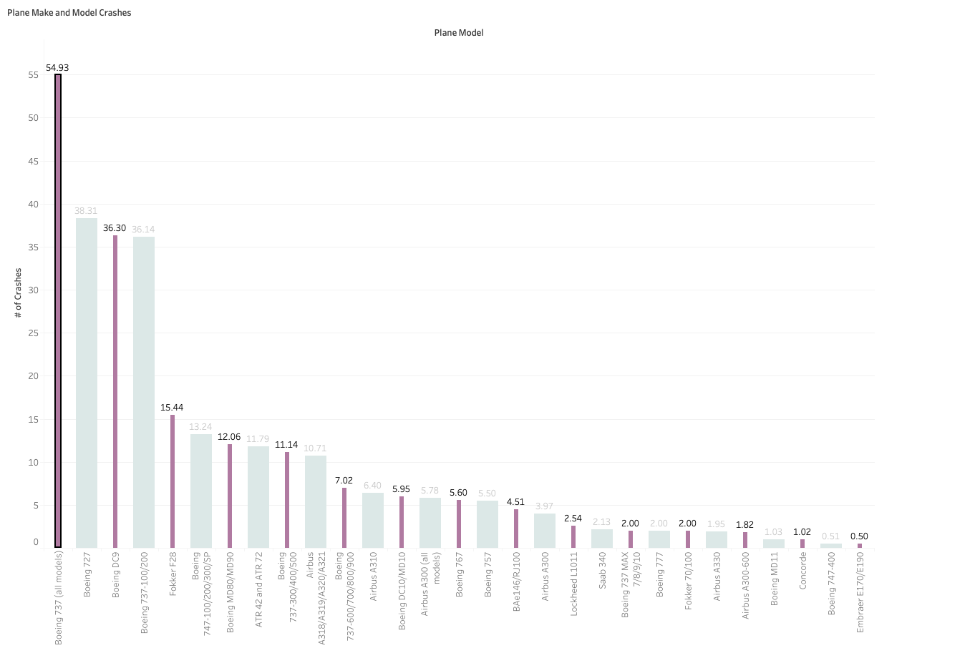
Plane Crash by Model
Boeing 737 did show that they had the most crashes; other Boeing models had 11 events in with in 100 million flights. But on a crash/mile flown basis it is still in the top third safest flights.

Slide 7
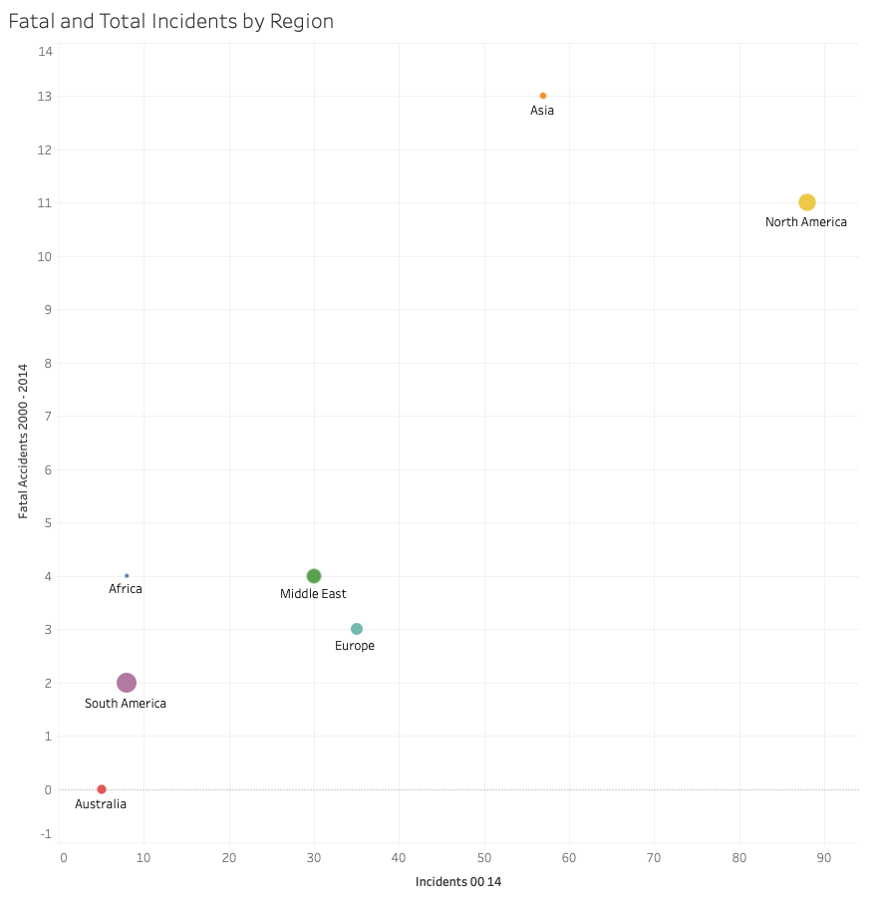
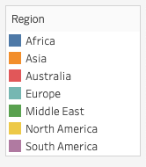
Global Travel
More than 22% of incidents involving Asia-based carriers were fatal
About 12% North American carriers had the third lowest percentage of fatal accidents
Australian carriers had a 0% fatality rate

Slide 8
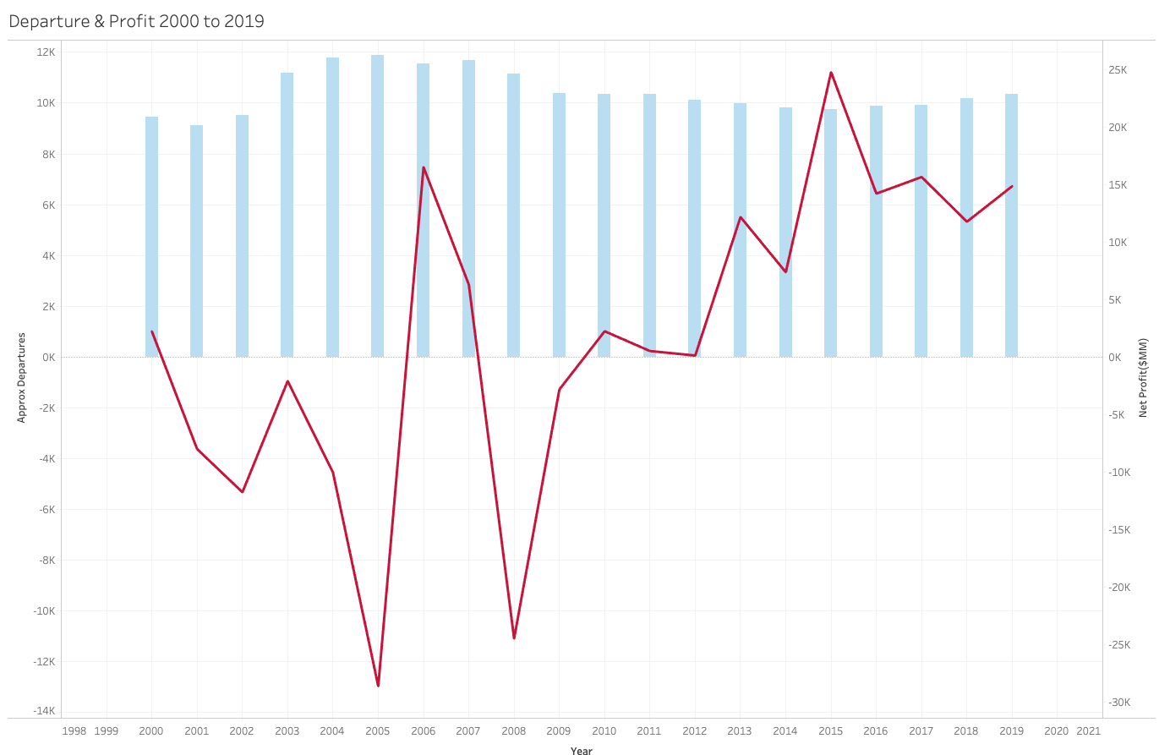
Travelers and profits
Global profit has decreased in 2005 and 2008 but increased in 2015 and this did not impact travel plan.
COVID-19 will and influence revenue, but the industry has recovered quickly
Airline continue to ensure safety as their gold standards
Air travel will continue to be safe and grow in profit for years to come

Slide 9



It’s a proven facts that air travel is safer than automobile
Find a destination
1
Book a flight
2
Travel safe
3
MAKE A PLAN

Slide 10

Thank you

Slide 11

References
Airline Safety, GitHub
Aviation Safety Network, Flight Safety Foundation
Accidents and Fatalities Pery Year
Crash Stats & Reports, NHTSA
Fatality Analysis Reporting System (FARS), NHTSA
Data Catalog, Data.Gov
Crash Datasets, Data.World
Economic Impact of Commercial Aviation By State, Airlines for America
Traffic and Capacity by Operating Region, Airline Data Project
Statistics, Bureau of Aircraft Accident Archives
ASN Aviation Safety Database, Aviation Safety Network

